Slide 1
Authorship Attribution for Neural Text Generation
(Synthetically generated text detection)
Venkatanand Sai Duggirala (VDUGGIRA)
Sarwabowma Sri Sai Karthikeya Sarraju (SARWABOW)
Harinath Reddy Cingapuram (HCINGAPU)
Sai Lakshmi Tejaswini Kallakuri (KALLAKUR)
Team: Author Finder

Slide 2
Abstract
There are tremendous advancements in Natural Language Processing, such as the OpenAI chatbot models. These technologies could be used in many ways to help the society but simultaneously could pose certain risks either with or without guilt. Thus in this project we would analyze some of the research done till date in order to solve the problem. Three problems would be analyzed, that is if two texts are generated by the same NLG, if text is from a human, and classify the texts with respect to the NLG. We consider some of the Neural Language Generation (NLG) models such as GPT-3 and try researching different Linguistic Features such as POS statistics, stylometric features and so on.
Keywords: Natural Language Processing, Neural Language Generation, Linguistic Features.

Slide 3
Introduction
With the developments in the field of chatbots which could mimic the human language, there’s a high ground for the models to be used as part of the deep fakes. Thus in this project we have analyzed various prior work in order to solve the following three questions.
Same or not: Whether the generated text is from the same NLG method (human) or not.
Human vs bot: Whether the text is from a human or an NLG method.
Which NLG method: Whether the text is from the i^{th} NLG method from a set of k methods.
The above questions are typical binary or multi label classification problems. Hence the papers reviewed would deal with the domain of the classification of text using different Machine Learning, Deep Learning models such as the RNN and so on.

Slide 4
Prior Work
Experiments with Convolutional Neural Networks (CNN) for Multi-Label Authorship Attribution: by Dainis Boumber, Yifan Zhang, Arjun Mukherjee.
Style-aware Neural Model with Application in Authorship Attribution: by Fereshteh Jafariakinabad, Kien A. Hua.
Exploring syntactic and semantic features for authorship attribution: by Haiyan Wu, Zhiqiang Zhang, Qingfeng Wu.
Leveraging Discourse Information Effectively for Authorship Attribution: by Su Wang, Elisa Ferracane, Raymond J. Mooney.
An evaluation of authorship attribution using random forests: by Mahmoud Khonji, Youssef Iraqi, Andrew Jones.
Authorship Attribution vs. Adversarial Authorship from a LIWC and Sentiment Analysis Perspective: by Joshua Gaston, Mina Narayanan, Gerry Dozier, D. Lisa Cothran, Clarissa Arms-Chavez, Marcia Rossi, Michael C. King, Jinsheng Xu.
Topic or Style? Exploring the Most Useful Features for Authorship Attribution: by Yunita Sari, Mark Stevenson and Andreas Vlachos.

Slide 5
Datasets
Each of the tasks have been considered separately hence the datasets were also prepared separately.
The data is taken from the 10 NLG methods (CTRL, GPT, GPT2, GPT3, Instruct GPT, GROVER, XLM, XLNET, PPLM, FAIR) and 1 human.
For task 1 which is a binary classification problem, the dataset consists of two columns chat1 & chat2; and also a third label column with two classes True and False. There are two sets one balanced (1:1) and another imbalance (1:10) b/w true & false[1].
For task 2, two sets, where one is balanced (1:1) and another imbalance (1:10)[1].
For task 3 we have prepared a large dataset consisting of all the NLG methods and a human along with labels corresponding to each generator[1].

Slide 6
Reddit Dataset
Data extracted using PRAW method and using the different topic names.
We have data from 2 NLG methods (GPT3, InstructGPT) and a human.
For task 1 the dataset has 2 chat columns and binary label column.
For this task we have balanced set (1:1) and imbalanced set (1:2).
For task 2 the dataset has one chat column and one binary label column.
The dataset is split into 2 sets one for balanced (1:1) and another for imbalanced (1:2).
For task 3 we have 3 labels with a single chat column.

Slide 7
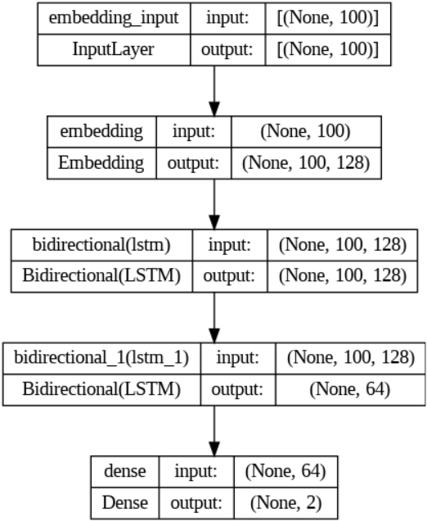
Methods & Models
We have considered basic four models
for our tasks 1 to 3.
First method and model:
  Preprocessed (punctuations,
stopwords removed & lowercase).
  Used a normal tokenization.
  BiLSTM architecture with 64 units in
first layer and 32 in next.

Slide 8
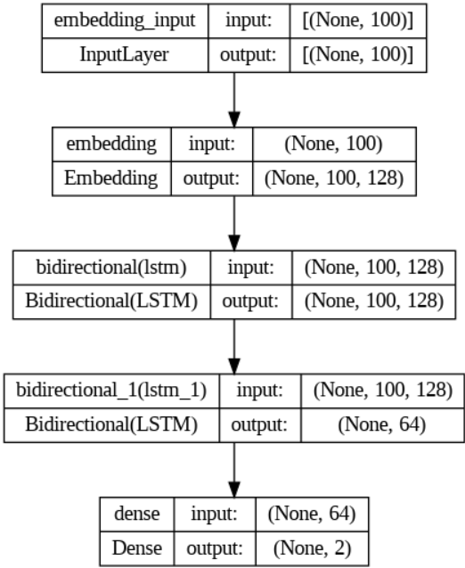
Second method and model:
  No preprocessing.
  BERT Tokenization.
  BiLSTM architecture with 64 units in
first layer and 32 in next.

Slide 9
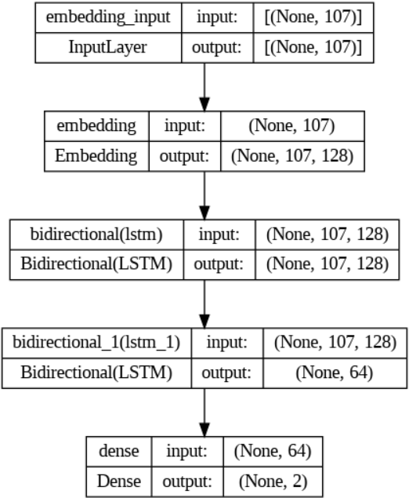
Third method and model:
  No preprocessing.
  BERT Tokenizer.
  Stylometric features ( avg word len,
avg sentence len, vocab size, lexical
diversity, nn count, vb count, adj count)
  BiLSTM architecture with 64 units in
first layer and 32 in next.

Slide 10
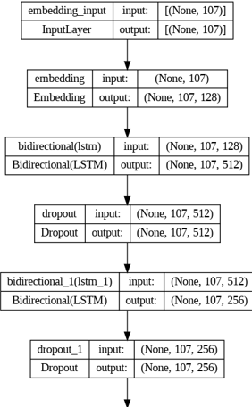
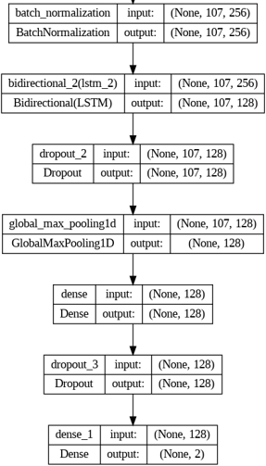
Fourth method and model:
  No preprocessing.
  BERT Tokenizer.
  Stylometric features[14].
  BiLSTM architecture
with max-pooling,
batch normalization &
dropout layers.

Slide 11
Fifth Method and Model Used:
Parameter Grid: Defined a grid of hyper-parameters.
(C: This is the regularization parameter, gamma: This is the kernel coefficient for 'rbf', 'poly' and 'sigmoid’, kernel: This is the kernel type to be used in the algorithm, learning_rate, n_estimators
)
Grid SearchCV: It then performs a grid search using GridSearchCV(). This process trains a SVM/XGBClassifier model for every combination of parameters in the grid and uses cross-validation to determine which combination results in the highest performance
Oversampling with SMOTE: It uses the Synthetic Minority Over-sampling Technique (SMOTE) to handle imbalanced data.
Model Used - XBBoost Classifiers

Slide 12
Flow
    Data
Tokenization
Spilt train and test
Classification Models
Hyper-Parameter Tuning
Stylo Metrics

Slide 13
Training and Validation
Used early stopping with callbacks with patience 3.
Dataset split into 80:20 ratio for testing.
The same for validation.
Stratified split of the dataset.
Trained for 30 epochs on Google colab Tesla T4 or V100 GPU.
Trained once on a balanced dataset.
Trained another one on an imbalanced set.

Slide 14
Milestone 2
The baseline model is a simple BiLSTM model with GloVe embeddings.
We got 0.40 F1 score on task 1.
For task 2 we got 0.19
For task 3 we got 0.40.

Slide 15
Testing and Evaluation
Task 1:
Model | Balanced (1:1) |  |  | Imbalanced (1:10)
 | Precision | Recall | F1-score | Precision | Recall | F1-score
Tokenizer + BiLSTM | 0.60 | 0.59 | 0.58 | 0.59 | 0.56 | 0.56
BERT + BiLSTM | 0.55 | 0.55 | 0.54 | 0.58 | 0.55 | 0.55
Style + BiLSTM | 0.48 | 0.48 | 0.44 | 0.36 | 0.50 | 0.42
Style + BiLSTM + maxpooling | 0.56 | 0.53 | 0.44 | 0.84 | 0.56 | 0.53
GridsearchCV+XB Boost | 0.84 | 0.79 | 0.81 | 0.92 | 0.86 | 0.89

Slide 16
Task 2:
Model | Balanced (1:1) |  |  | Imbalanced (1:10)
 | Precision | Recall | F1-score | Precision | Recall | F1-score
Tokenizer + BiLSTM | 0.82 | 0.82 | 0.82 | 0.80 | 0.64 | 0.68
BERT + BiLSTM | 0.79 | 0.75 | 0.77 | 0.73 | 0.81 | 0.76
Style + BiLSTM | 0.85 | 0.84 | 0.84 | 0.86 | 0.85 | 0.85
Style + BiLSTM + maxpooling | 0.85 | 0.85 | 0.85 | 0.87 | 0.83 | 0.85

Slide 17
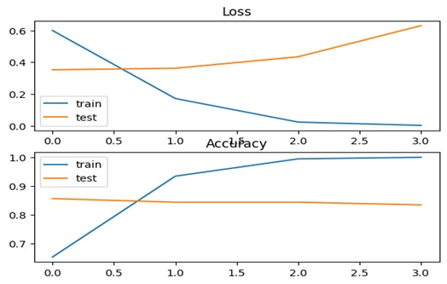
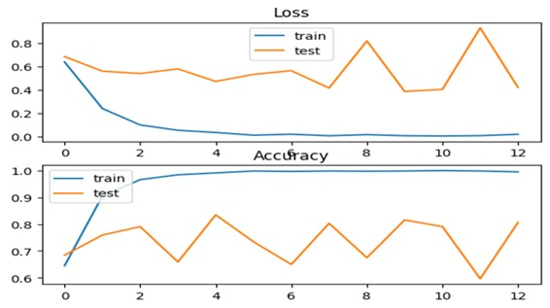
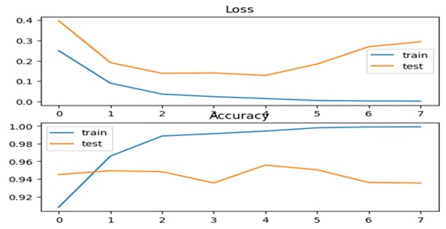
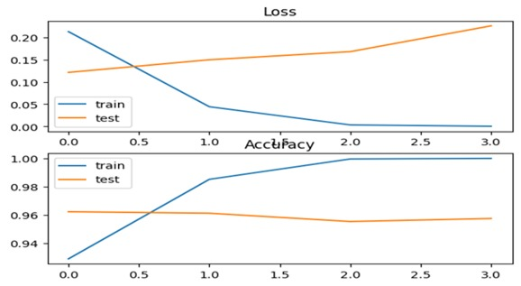
Task 1 and 2 Loss and accuracy graphs
TASK1 BALANCED TASK 1 IMBALANCED

Slide 18
Task 3:
Model | GPT-2 | InstructGPT | Human | Xlnet | Fair | GPT | Ctrl | PPLM | Grover | GPT-3 | XLM | Average F1 Score
Tokenizer + BiLSTM | 0.94 | 0.40 | 0.96 | 0.54 | 0.45 | 0.33 | 0.48 | 0.57 | 0.74 | 0.97 | 0.93 | 0.66
BERT + BiLSTM | 0.94 | 0.49 | 0.95 | 0.56 | 0.70 | 0.39 | 0.58 | 0.67 | 0.70 | 0.97 | 0.92 | 0.72
Style + BiLSTM | 0.95 | 0.63 | 0.97 | 0.71 | 0.73 | 0.61 | 0.69 | 0.69 | 0.74 | 0.97 | 0.94 | 0.78
Style + BiLSTM + max-pooling | 0.96 | 0.65 | 0.95 | 0.68 | 0.75 | 0.49 | 0.71 | 0.75 | 0.79 | 0.98 | 0.96 | 0.79
Random Forest | 0.53 | 0.61 | 0.74 | 0.99 | 0.49 | 0.99 | 0.98 | 0.67 | 0.61 | 0.59 | 1.00 | 0.75
BERT+Random Forest | 0.14 | 0.63 | 0.45 | 0.40 | 0.18 | 0.61 | 0.20 | 1.00 | 0.17 | 0.52 | 0.67 | 0.45
Attention+Random Forest | 0.53 | 0.60 | 0.52 | 0.83 | 0.51 | 0.91 | 0.89 | 0.72 | 0.29 | 0.54 | 0.96 | 0.66

Slide 19
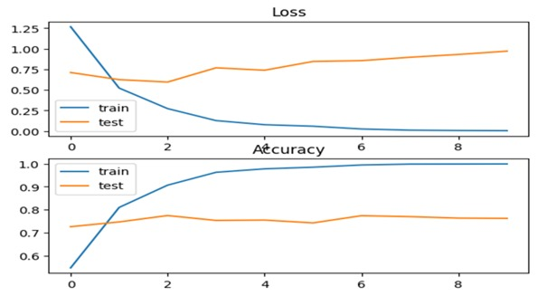
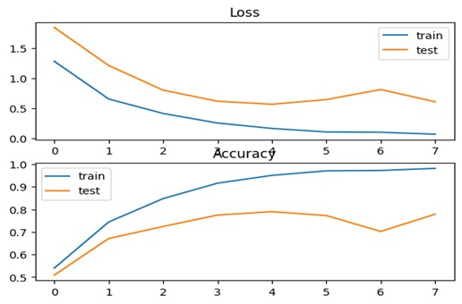
Task 3 Loss and accuracy graphs

Slide 20
Highlights
On the imbalanced set in task 2 we have got good results with BiLSTM model with max-pooling layer compared with the author.
For task 3 on GPT2 and GROVER we have got good results with BiLSTM model with max-pooling layer compared to that of the original author.
According to the author the GROVER is one of the tough datasets on which the stacked CNN, parallel CNN models gave fair results[1].
Comparing to that of the human generated texts the Style + BiLSTM model has edge over random forests model.

Slide 21
Task 1 Reddit
Model | Balanced (1:1) |  |  | Imbalanced (1:2)
 | Precision | Recall | F1-score | Precision | Recall | F1-score
Tokenizer + BiLSTM | 0.56 | 0.56 | 0.56 | 0.58 | 0.54 | 0.51
BERT + BiLSTM | 0.62 | 0.62 | 0.61 | 0.64 | 0.64 | 0.54
Style + BiLSTM | 0.68 | 0.66 | 0.65 | 0.69 | 0.64 | 0.65
Style + BiLSTM + maxpooling | 0.70 | 0.65 | 0.63 | 0.85 | 0.55 | 0,51
GridsearchCV+XGBoost | 0.77 | 0.75 | 0.76 | 0.92 | 0.86 | 0.89

Slide 22
Task 2 Reddit
Model | Balanced (1:1) |  |  | Imbalanced (1:2)
 | Precision | Recall | F1-score | Precision | Recall | F1-score
Tokenizer + BiLSTM | 0.95 | 0.91 | 0.92 | 0.91 | 0.94 | 0.92
BERT + BiLSTM | 1.00 | 1.00 | 1.00 | 1.00 | 0.99 | 0.99
Style + BiLSTM | 0.97 | 0.97 | 0.97 | 0.98 | 0.96 | 0.97
Style + BiLSTM + maxpooling | 0.94 | 0.94 | 0.94 | 0.96 | 0.92 | 0.94

Slide 23
Task 3 Reddit
Model | GPT-3 | Instruct GPT | Human | Average
Tokenizer + BiLSTM | 0.69 | 0.86 | 0.63 | 0.73
BERT + BiLSTM | 0.73 | 0.97 | 0.65 | 0.78
Style + BiLSTM | 0.71 | 0.95 | 0.63 | 0.77
Style + BiLSTM + maxpooling | 0.75 | 0.93 | 0.68 | 0.79

Slide 24
Reddit Case Study Highlights
On task 1 Style + BiLSTM model has given pretty good results for balanced set.
It performed well on imbalanced set too but with low precision.
On task 2 BERT + BiLSTM model has given good results in contrast to task 2 on the original set.
On task 3 Style + BiLSTM + max-pooling model has given pretty good results similar to the original set.

Slide 25
Conclusion
The models implemented performed well in some areas[1].
In other places the author’s model has performed well or the Random Forests model.
The Stylometric features have played a better role in extracting the information[6].
The style analysis combined with the POS estimation gave us the insight into the grammatical syntactic structure of the chat[6].
A powerful pretrained tokenizer such as the BERT has also proven to be useful.

Slide 26
References
1. Adaku Uchendu, Thai Le, Kai Shu, and Dongwon Lee. 2020. Authorship Attribution for Neural Text Generation. In Proceedings of the 2020 Conference on Empirical Methods in Natural Language Processing (EMNLP), pages 8384–8395, Online. Association for Computational Linguistics.
2. Dainis Boumber, Yifan Zhang, and Arjun Mukherjee. 2018. Experiments with convolutional neural networks for multi-label authorship attribution. In Proceedings of the Eleventh International Conference on Language Resources and Evaluation (LREC 2018).
3. F. Jafariakinabad and K. A. Hua, "Style-Aware Neural Model with Application in Authorship Attribution," 2019 18th IEEE International Conference On Machine Learning And Applications (ICMLA), Boca Raton, FL, USA, 2019, pp. 325-328, doi: 10.1109/ICMLA.2019.00061.
4. Haiyan Wu, Zhiqiang Zhang, Qingfeng Wu, “Exploring syntactic and semantic features for authorship attribution”, Applied Soft Computing, Volume 111, 2021, 107815, ISSN 1568-4946, https://doi.org/10.1016/j.asoc.2021.107815.
5. Stamatatos E., A survey of modern authorship attribution methods, J. Am. Soc. Inf. Sci. Technol. 60 (3) (2009) 538–556.
6. R. Zhang, Z. Hu, H. Guo, Y. Mao, Syntax encoding with application in authorship attribution, in: Proceedings of the 2018 Conference on Empirical Methods in Natural Language Processing, 2018, pp. 2742–2753
7. Jafariakinabad F., Tarnpradab S., Hua K.A., Syntactic recurrent neural network for authorship attribution, 2019, arXiv preprint arXiv:1902.09723.

Slide 27
8. Q. Li, Z. Li, J.-M. Wei, Y. Gu, A. Jatowt, Z. Yang, A multi-attention based neural network with external knowledge for story ending predicting tasks, in: Proceedings of the 27th International Conference on Computational Linguistics, 2018, pp. 1754–1762.
9. Ruder S., Ghaffari P., Breslin J.G., Character-level and multi-channel convolutional neural networks for
large-scale authorship attribution, CoRR abs/1609.06686 (2016).
10. Elisa Ferracane, Su Wang, and Raymond Mooney. 2017. Leveraging discourse information
effectively for authorship attribution. In Proceedings of the Eighth International Joint Conference on
Natural Language Processing (Volume 1: Long Papers), pages 584–593.
11. R. Caruana and A. Niculescu-Mizil, "An empirical comparison of supervised learning algorithms", Proceedings of the 23rd International Conference on Machine Learning, pp. 161-168, 2006.
12. M. Khonji, Y. Iraqi and A. Jones, "An evaluation of authorship attribution using random forests," 2015 International Conference on Information and Communication Technology Research (ICTRC), Abu Dhabi, United Arab Emirates, 2015, pp. 68-71, doi: 10.1109/ICTRC.2015.7156423.
13. J. Gaston et al., "Authorship Attribution vs. Adversarial Authorship from a LIWC and Sentiment Analysis Perspective," 2018 IEEE Symposium Series on Computational Intelligence (SSCI), Bangalore, India, 2018, pp. 920-927, doi: 10.1109/SSCI.2018.8628769.

Slide 28
14. Yunita Sari, Mark Stevenson, and Andreas Vlachos. 2018. Topic or Style? Exploring the Most Useful Features for Authorship Attribution. In Proceedings of the 27th International Conference on Computational Linguistics, pages 343–353, Santa Fe, New Mexico, USA. Association for Computational Linguistics.
15. Hugo Jair Escalante, Thamar Solorio, and Manuel Montes-y Gomez. 2011. Local Histograms of Character ´ N-grams for Authorship Attribution. In Proceedings of the 49th Annual Meeting of the Association for Computational Linguistics: Human Language Technologies - Volume 1, HLT ’11, pages 288–298, Stroudsburg, PA, USA. Association for Computational Linguistics.
16. Ahmed Abbasi and Hsinchun Chen. 2008. Writeprints: A Stylometric Approach to Identity-level Identification and Similarity Detection in Cyberspace. ACM Transactions on Information Systems (TOIS), 26(2).
17. Yanir Seroussi, Ingrid Zukerman, and Fabian Bohnert. 2013. Authorship Attribution with Topic Models. Journal Computational Linguistics, 40(2):269–310.

Slide 29
Thank you !!!

